Slide 1
Show me the money
Bailey Korfhage

Slide 2
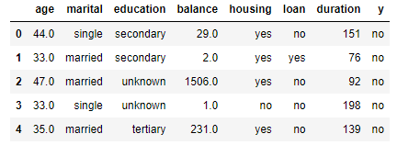
overall
Prediction of term deposit purchases
Used over 40,000 entries and 8 columns
4 discrete variables, 3 continuous

Slide 3
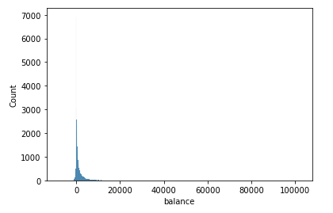
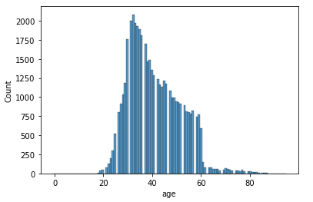
Preparation of the data
Two columns with missing values
Both were skewed, required median
Using get_dummies for categorical

Slide 4
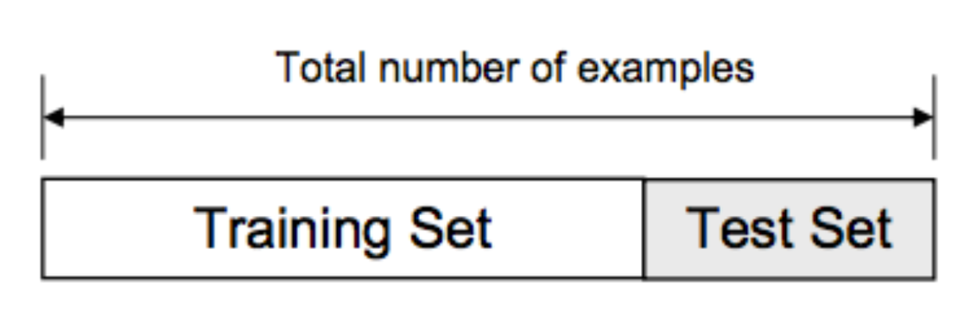
splitting
3 experiments using sklearn
60/40 split
80/20 split
90/10 split
Used the logistic regression library

Slide 5
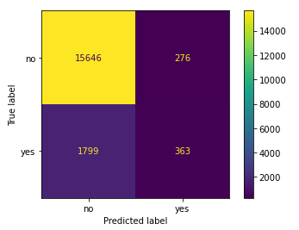
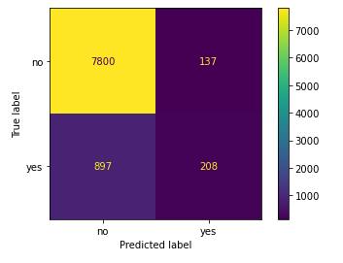
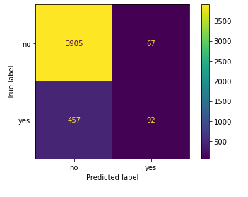
results
EXPERIMENT 1: .89 accuracy
EXPERIMENT 2: .89 accuracy
EXPERIMENT 3: .88 accuracy

Slide 6
overall
Determining if a customer bought term deposit
Had to fill in missing values first
Splitting in different ratios
Accuracy score is going to determine true versus false

